Slide 1

Content based image retrieval
M1 - Introduction to Human and Computer Vision
Week 1
Igor Ugarte Molinet
Juan Antonio Rodríguez García
Francesc Net Barnès
David Serrano Lozano

Slide 2
Contents
01
02
03
04
Problem
Method Query Set 1
Method Query Set 2
Results
Description of the problems to solve
Images cropped right in the frame
Images with background
Description of results for QS1 and QS2
Beginning
End

Slide 3
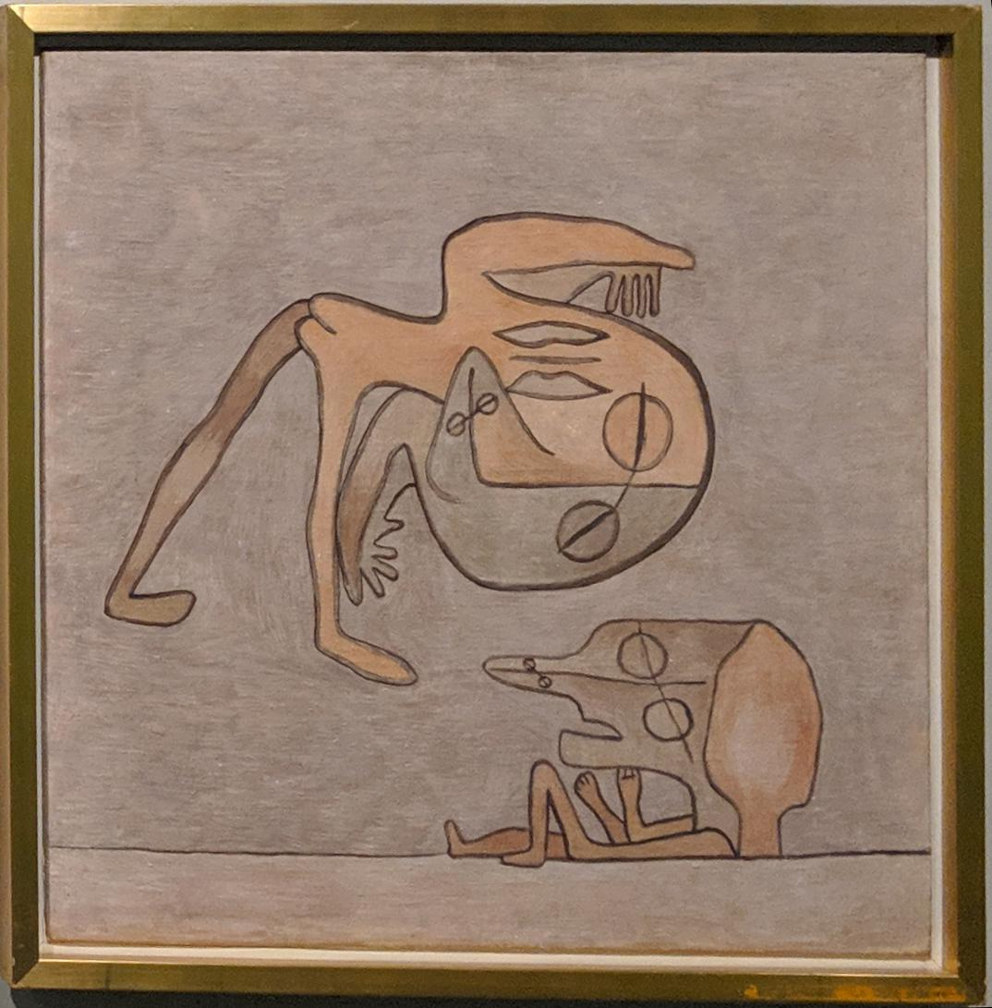
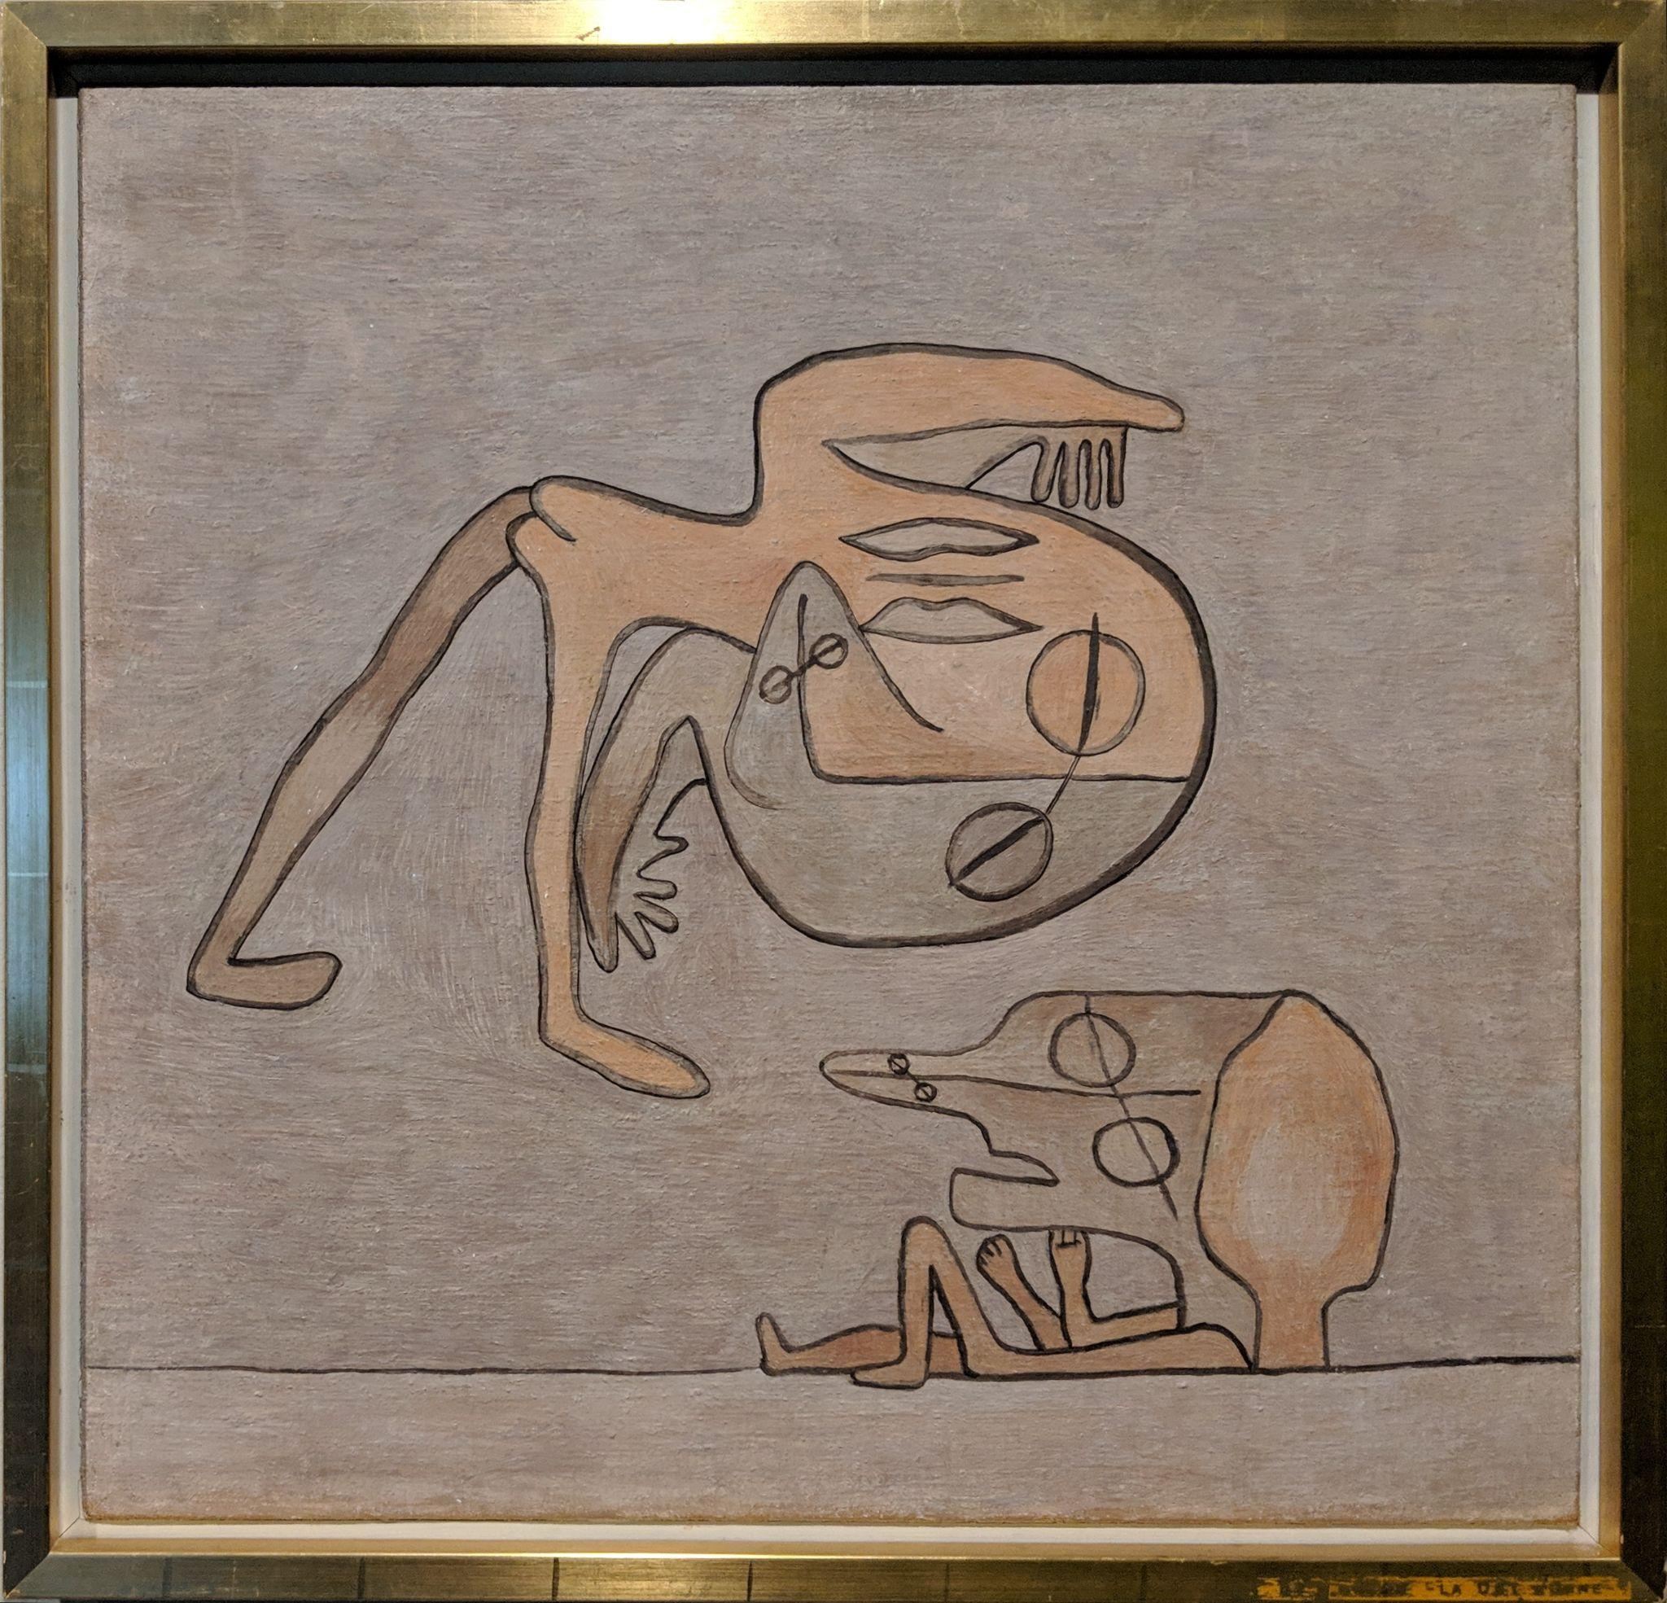
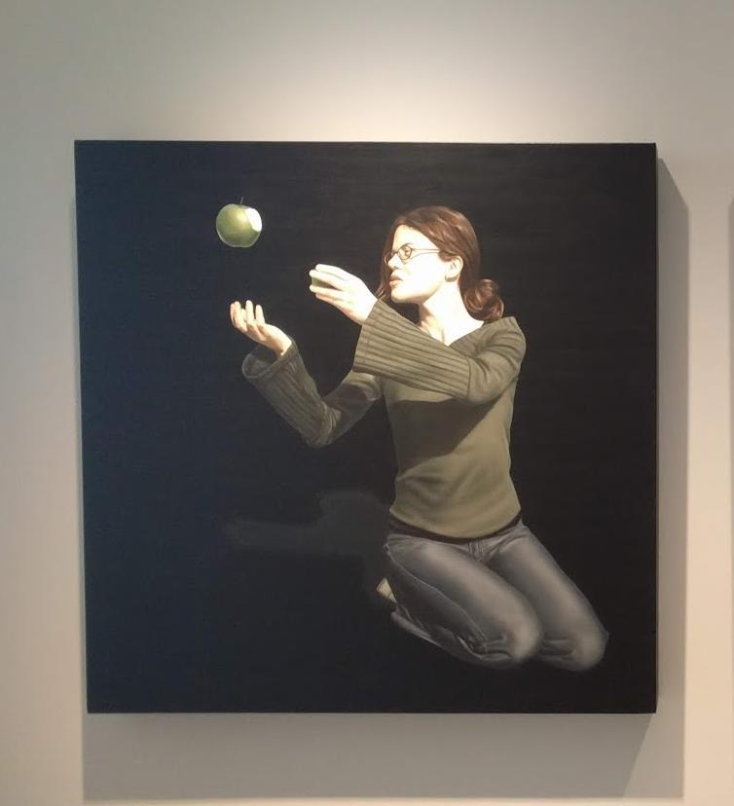
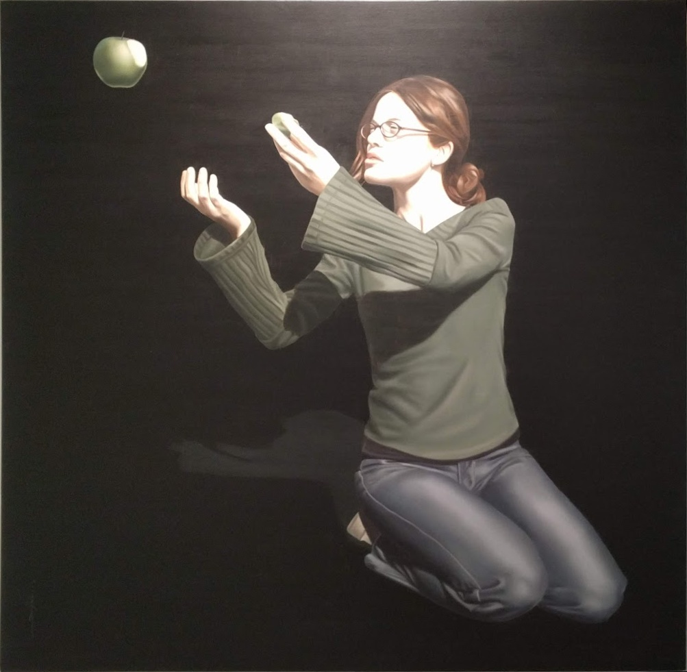
Problem: Two types of scenarios
Query Set 1
Database
Problem 1: Find the K most similar images for the given query
Images cropped right in the frame
Query Set 2
Database
Problem 2: Remove background to create the query + Problem 1
Images with some background

Slide 4
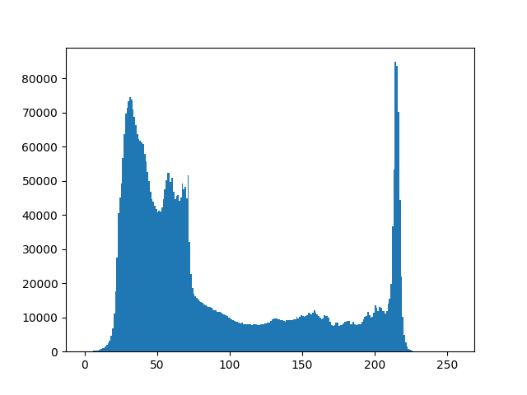
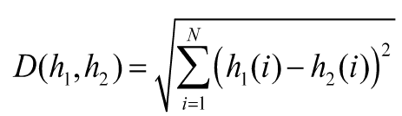
2. Method for Query Set 1
Histograms
Similarity
Query Images
&
Database Images
Retrieve the k best database images
Compute and normalize the histograms of all the query and database images
Compute the similarity between the query images and all the database images

Slide 5
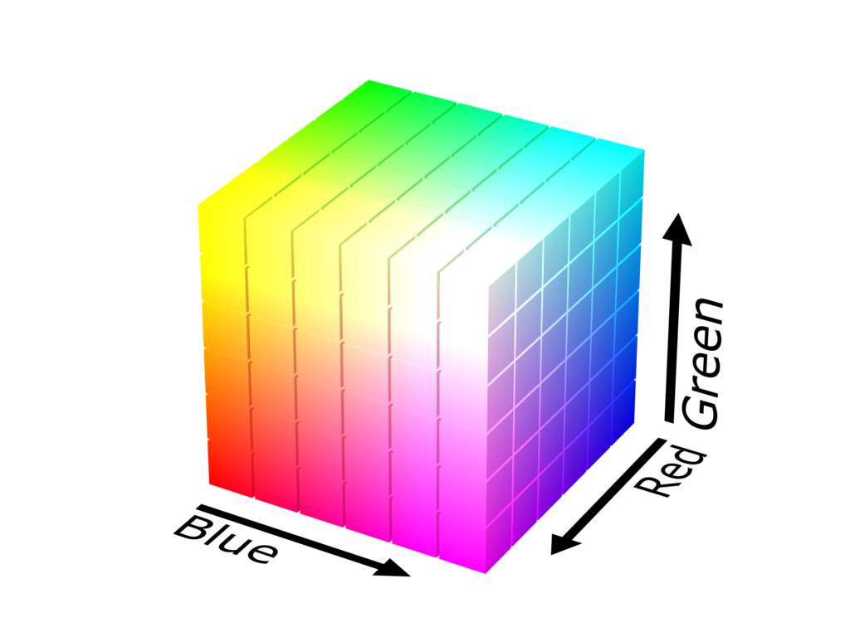
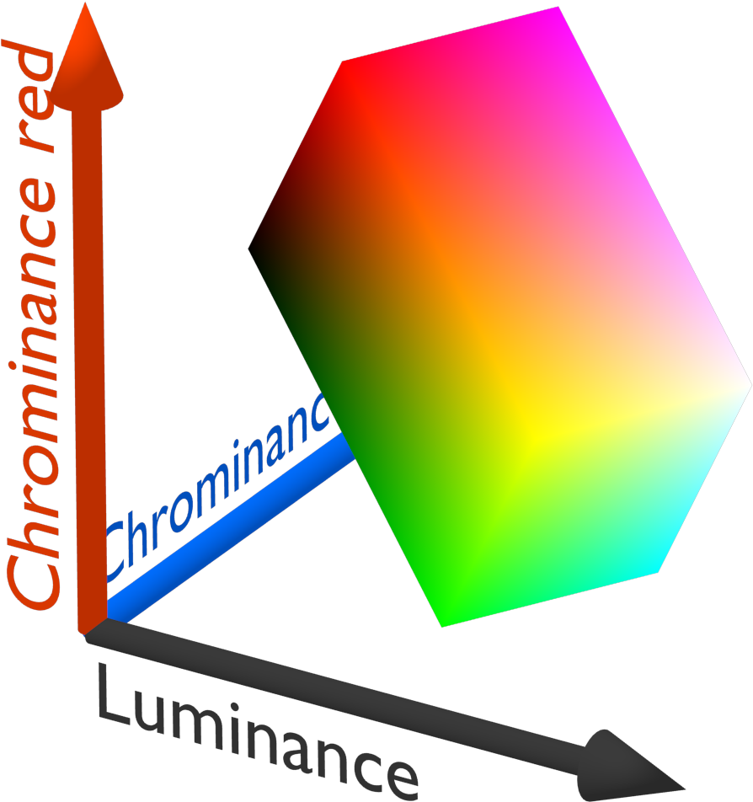
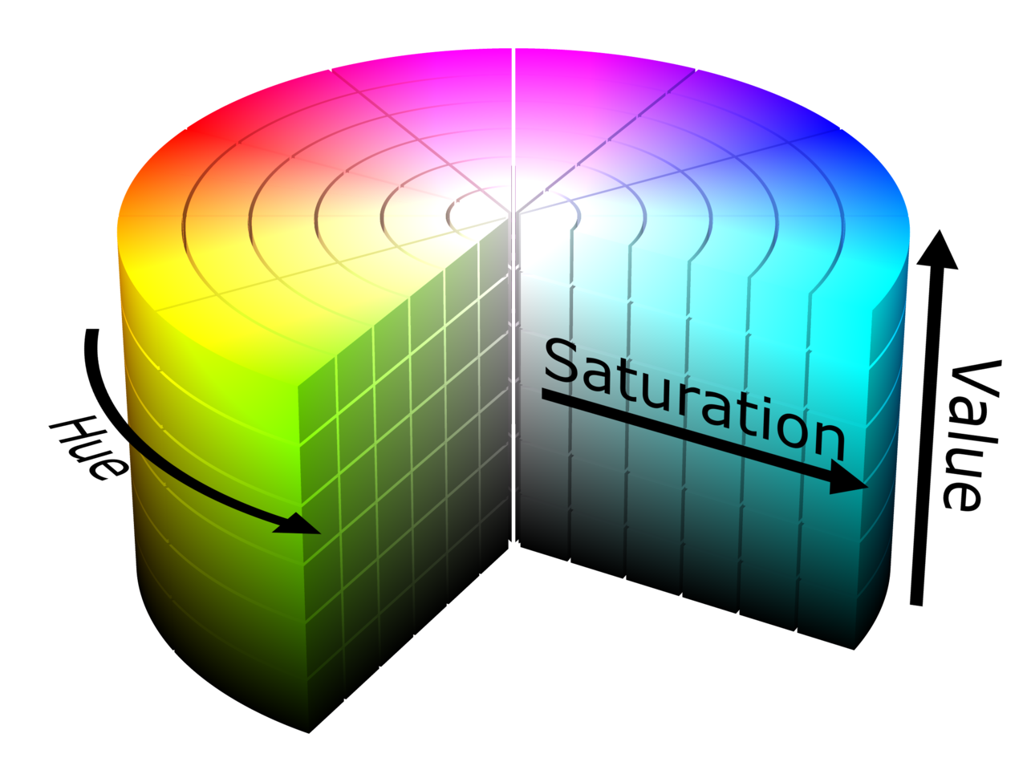
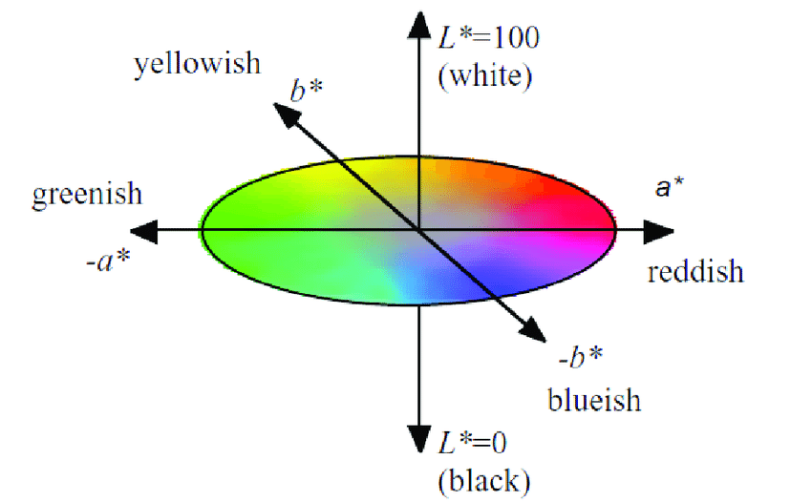
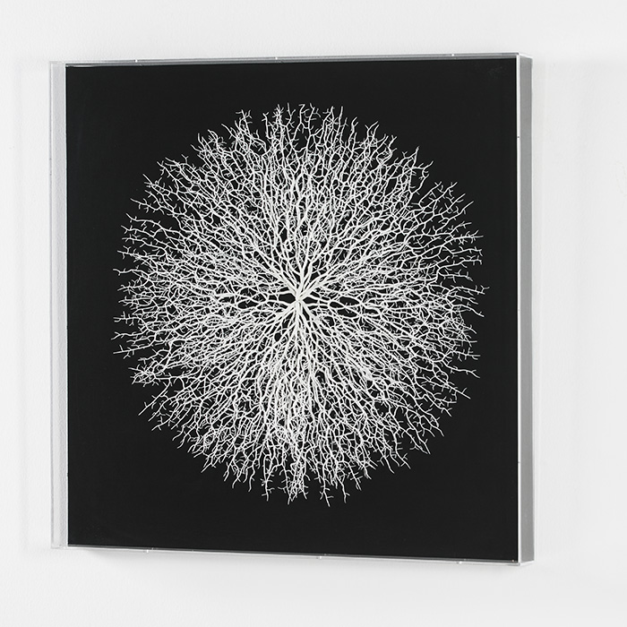
Histogram: Color space options
Gray level
RGB color space
YCbCr color space
HSV color space
CIELab color space

Slide 6
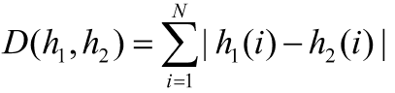
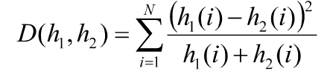
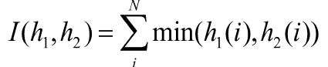
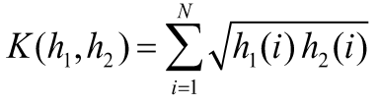
Similarity measure options
Euclidean distance:
L1/Manhattan distance:
Chi-Squared distance:
Histogram intersection:
Hellinger distance:

Slide 7
Find the best method for Image Retrieval
A method is defined by a pair of (color space CS, similarity measure S)
The assessment measure is MAP@K (Mean Average Precision at K)
Find the best method by an exhaustive search, creating a matrix of CS and S

Slide 8
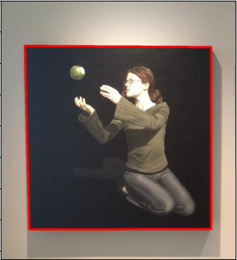
3. Method for Query Set 2
Subtract the background
Query Set 1 system
Query Images
&
Database Images
Retrieve the k best database images
Compute the histograms and the similarities as in the Query Set 1 system
Estimate and remove the background from the query images

Slide 9
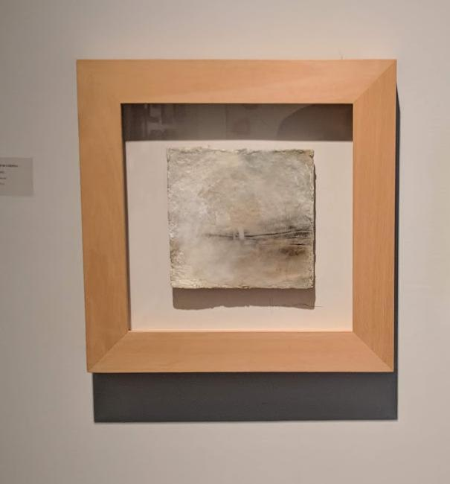
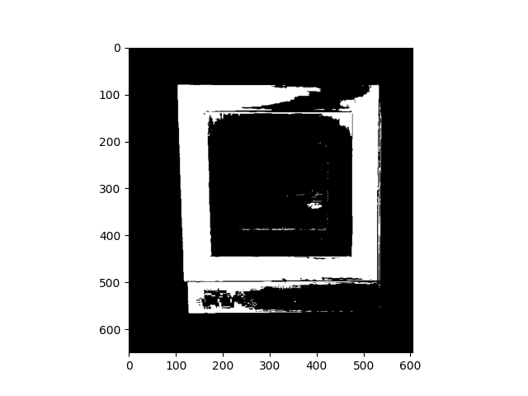
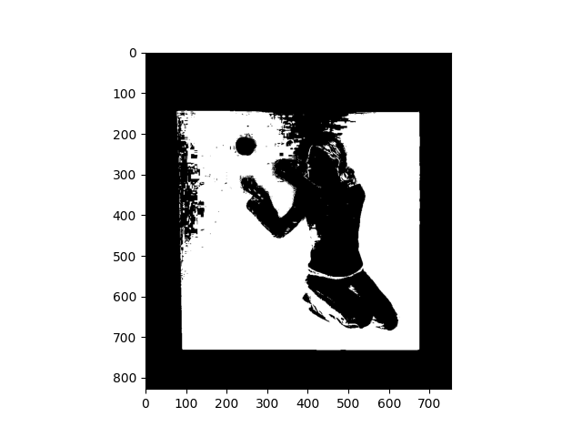
Using color distributions
Intuition: The background colors have higher gray and are brighter than paintings.
Method: Threshold Saturation and Value from HSV color space.
Original 1
Thresholded
Original
Thresholded

Slide 10
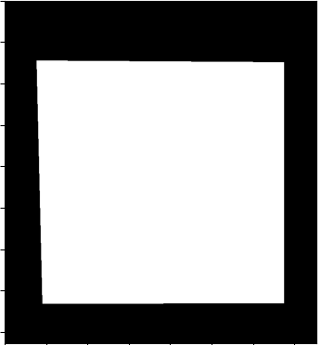
Using color distributions
Find picture edges:
Upper and bottom bounds: First and last nonzero elements index for each column.
Leave outliers out.
Take the right and left indexes for each bound → We have the edges!
Thresholded
Final mask
Comparison to original
Upper bound
Outliers for upper bound
Bottom bound

Slide 11
4. Results I: Query Set 1 (Development)
Three best methods for cropped paintings
 | map@1 | map@5
Method 1 | 0.5000 | 0.5417
Method 2 | 0.5372 | 0.4667
Method 3 | 0.5056 | 0.4667
Method 1: YCrCb color space with Chi-Squared distance
Method 2: HSV color space with histogram intersection
Method 3: YCrCb color space with hellinger distance

Slide 12
4. Results II: Query Set 2 (Development)
With the query set 2 images (images with some background)
 | map@1 | map@5
Method 1 | 0.5667 | 0.6194
Method 2 | 0.5667 | 0.5750
Method 3 | 0.5333 | 0.5594
Method 1: YCrCb color space with Chi-Squared distance
Method 2: RGB color space with Chi-Squared distance
Method 3: YCrCb color space with histogram intersection

Slide 13
4. Results (III)
To evaluate the Background subtraction system the precision, recall and F1 metrics are used.
With the query set 1 images (images cropped right in the frame)
 | Precision | Recall | F1-measure
Method 1 | 98.6% | 97.55% | 98.04%
Method 2 | 98.53% | 97.55% | 97.96%
Method 3 | 98.6% | 97.38% | 97.94%
Method 1: Saturation = 114, Value = 63
Method 2: Saturation = 114, Value = 62
Method 3: Saturation = 114, Value = 61

Slide 14
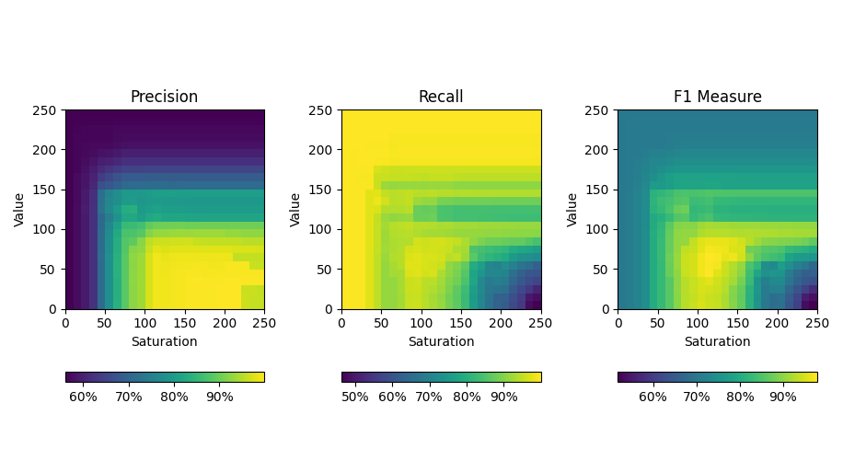
4. Results (III)
To evaluate the Background subtraction system the precision, recall and F1 metrics are used.
With the query set 1 images (images cropped right in the frame)
Best zone
Method 1: Saturation = 114, Value = 63
Method 2: Saturation = 114, Value = 62
Method 3: Saturation = 114, Value = 61

Slide 15
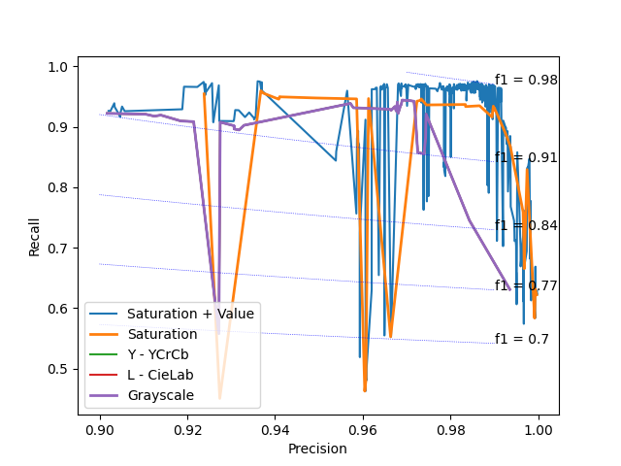
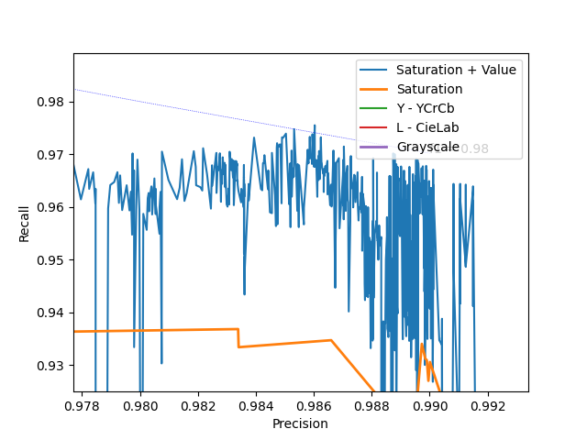
4. Results (III)
Comparison to other tried methods. Grayscale, Y channel from YCrCb, L from CieLab, S from HSV and V from HSV.
PR Curve
Best Solution
F1-measure = 0.9804
Precision = 0.986
Recall = 0.9755
Thresholds
Saturation = 114
Value = 63

Slide 16
Content based image retrieval
M1 - Introduction to Human and Computer Vision
Week 1
Thanks!
Igor Ugarte Molinet
Juan Antonio Rodríguez García
Francesc Net Barnès
David Serrano Lozano

